Slide 1
Title: Biometric polling School of Electronics and Communication Under the Supervision of Dr. Sudharshan M & Dr. Ravishankar D Harshitha J (R23EN057) Eshan Karthik (R23EN049) Aryan Sharma (R23EN024) Neeral Devni (R23EN204)
DATE: 09-05-2026

Slide 2
| CONTENTS
SL.NO | CONTENT | SLIDE NO.
1. | Abstract | 3
2. | Introduction | 4
3. | Objectives | 5
4. | Methodology | 6-7
5. | Working | 8-9
5. | Result | 10
6. | Future scope | 11
7. | Conclusion | 12
Abstract
Introduction
Objectives
Methodology
Working
Result
Future scope
Conclusion
2

Slide 3
| ABSTRACT
This project is a microcontroller based biometric polling system using ESP32 to enhance electronic voting security and accessibility.
The system stores fingerprint templates in secure biometric authentication which is mapped with image and unique ID.
Components such as an LCD display and switches enable user interaction and vote management.
The project highlights necessary measures and to develop a trustworthy e-voting system.
3

Slide 4
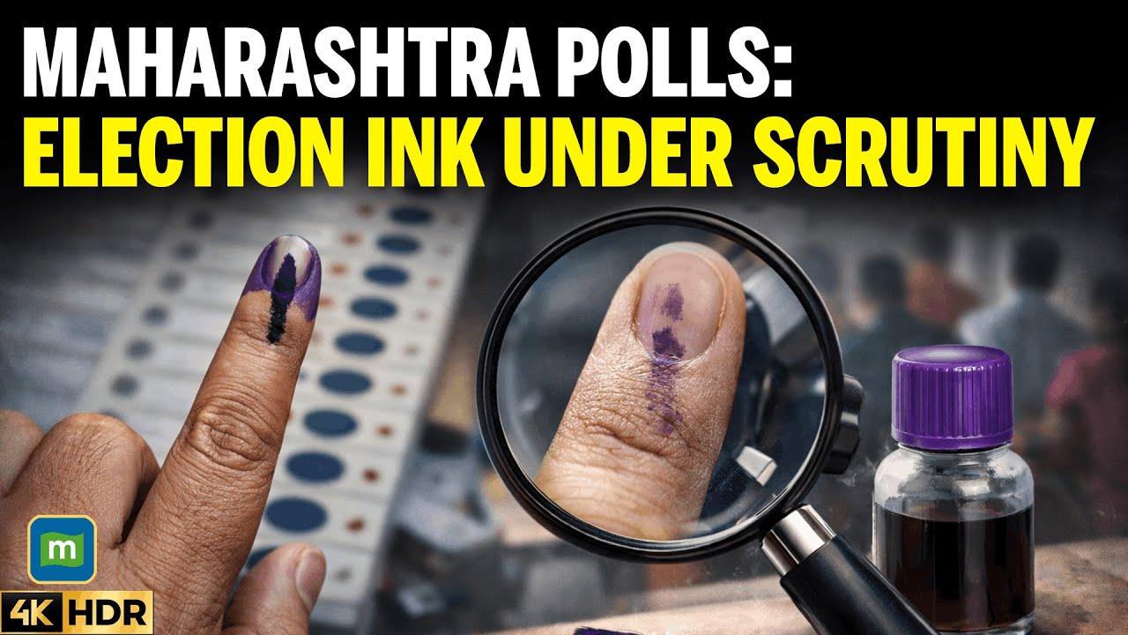
| INTRODUCTION
Election rigging is when individuals cast multiple or unauthorized votes.
Traditional methods, such as ink marks on fingernails, are easily manipulated and fail to ensure voter authenticity
This project is a built around the ESP32 microcontroller and the R307 fingerprint scanner.
R307- captures and converts fingerprint images into digital templates
ESP 32- interfaces with LCD display, switch array, and a buzzer
Fig 1.
Election rigging
Source: News18
4

Slide 5
| OBJECTIVES
Enhance Voting Security: using biometric verification
Increase Accuracy: eliminate manual errors in voter identification
Streamline the Voting Process: automate voter verification (minimizing delays)
Improve Voter Accessibility: provide a user-friendly system
Data Integrity and Authenticity: secure storing of votes
5

Slide 6
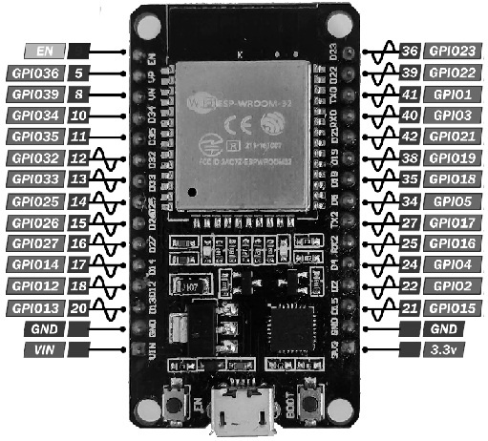
| METHODOLOGY
Hardware Components
ESP 32 Microcontroller:
Clock speed : 30MHz- 240MHz
Memory: 520Kb internal SRAM, 448Kb ROM
Wireless: WiFi+Blutooth
GPIO’s: 34+ programmable pins
Significantly higher processing power (dual-core 240MHz), built-in Wi-Fi and Bluetooth, and lower cost compared to Arduino UNO.
Fig 2. ESP32
6

Slide 7
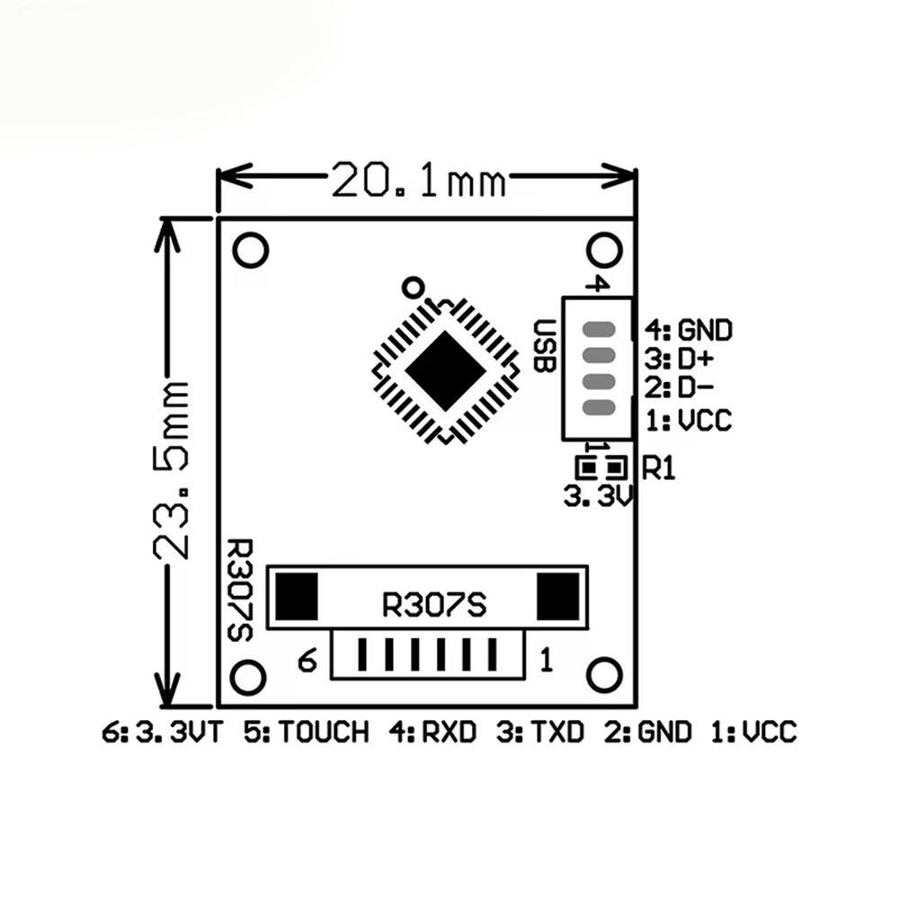
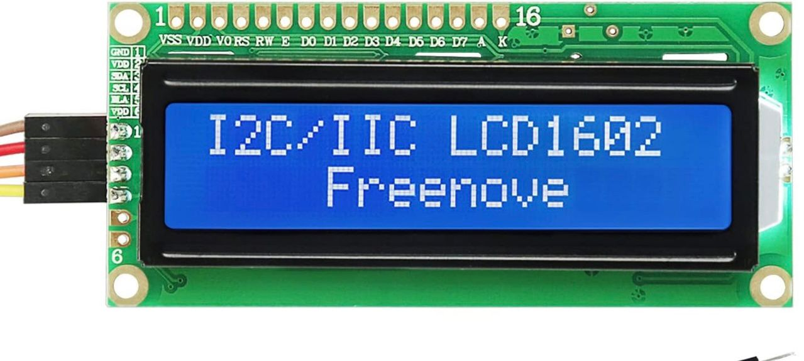
2. Fingerprint module (R307): optical fingerprint sensor module designed for biometric applications.
Operation: 3.6V–6.0V
Recognition speed: <1 second.
3. Push buttons: consists of multiple switches that can be connected to a microcontroller or processor.
4. Lcd ESP8266: an I2C LCD that uses the I2C communication protocol, which requires only two pins for communication:
Display: 16 x 2
Communication pins: SDA (data line) and SCL (clock line)
5. Additional components: webcam, buzzer, jumper wires
Fig 3. R307 Fingerprint module
Fig 4.Lcd ESP8266
7

Slide 8
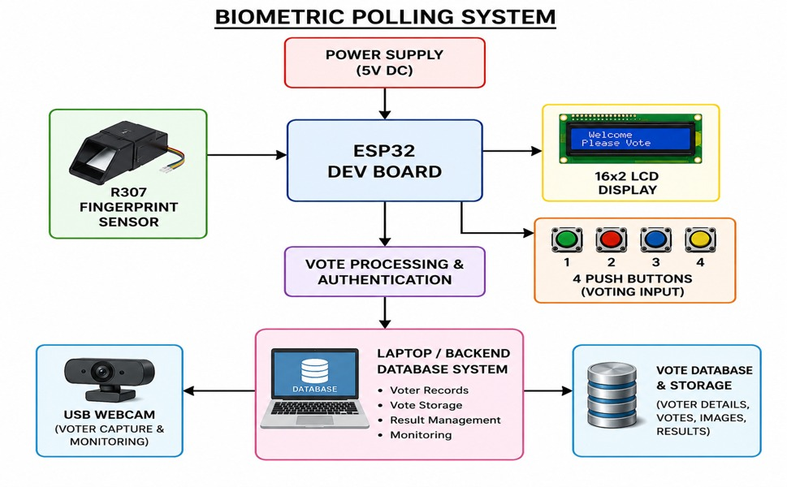
| WORKING
Block Diagram
Fig 4. block diagram
8

Slide 9





| WORKING
Steps to implement
Step 1:
Fingerprint Enrollment and
voter authentication
Step 2:
Image capture and
ID display
Step 4:
Data Logging
Python database
Step 5:
Results
Step 3:
Vote Casting
9

Slide 10

| FUTURE SCOPE
Additional Biometrics: iris recognition for added security
Server database: encryption polling data
AES encryption: stronger data security
Fig 5. Future work

Slide 11
| CONCLUSION
Biometric polling system offers secure, transparent, and accessible voting experiences.
This project portrays potential to become a global standard for elections.
By utilizing biometric authentication, it significantly reduces the risk of fraud.
This system not only streamlines the voting process, leading to quicker identification and faster results.

Slide 12
| REFERENCES
[1] Arduino IDE, “ESP32 Documentation,” Espressif Systems, 2025. [Online]. Available: Espressif ESP32 Documentation￼.
[2] ESP32 Datasheet, Espressif Systems, Shanghai, China, 2024.
[3] R307 Fingerprint Sensor User Manual, Hangzhou Grow Technology Co., Ltd., China, 2024.
[4] Internet of Things, “IoT Based Smart Electronic Voting Machine,” in International Journal of Engineering Research & Technology, vol. 9, no. 6, pp. 112–116, 2023.
[5] Biometric Authentication, A. K. Jain, A. Ross, and S. Prabhakar, “An Introduction to Biometric Recognition,” IEEE Transactions on Circuits and Systems for Video Technology, vol. 14, no. 1, pp. 4–20, Jan. 2004.
[6] Electronic Voting, D. Chaum, “Secret-Ballot Receipts: True Voter-Verifiable Elections,” IEEE Security & Privacy, vol. 2, no. 1, pp. 38–47, Jan.–Feb. 2004.
[7] LCD 16x2 Display Technical Specifications, 2024. [Online]. Available: 16x2 LCD Documentation￼.

Slide 13
THANK YOU

